Slide 1
Troubleshooting and use of tablets in the field

Slide 2
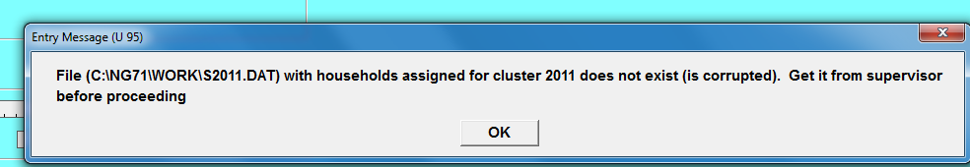
No assignment file
Problem | Solution
Error Message U95 Means that tablet does not have an assignment file. | Supervisor sends assignment file via Bluetooth transfer to the tablet
Notes:
Go through this section in the manual. It is a good idea to ask participants to read different sections before you explain the section.

Slide 3
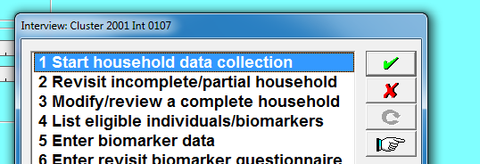
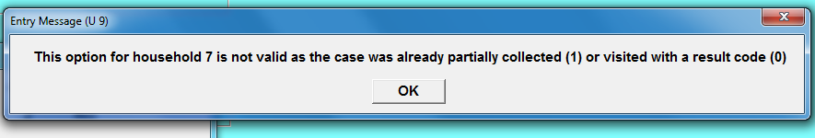
Can’t find or open an interview
Problem | Solution
Message U9 Using option 1 Start Interview when Interview has been partially saved OR Has been completed | Run option A: list questionnaires Check status of interview Use options 2 or 3 as appropriate
Notes:
Go through this section in the manual. It is a good idea to ask participants to read different sections before you explain the section.

Slide 4
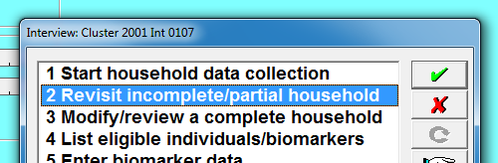
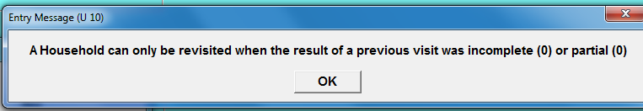
Can’t find or open an interview
Problem | Solution
Message U10 Using option 2 Modify when Interview hasn’t begun OR Has been completed | Run option A: list questionnaires Check status of interview Use options 1 or 3 as appropriate
Notes:
Go through this section in the manual. It is a good idea to ask participants to read different sections before you explain the section.

Slide 5
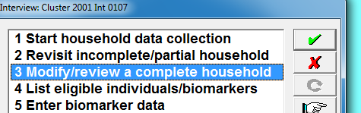
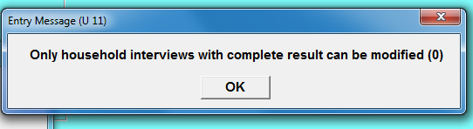
Can’t find or open an interview
Problem | Solution
Message U11 Using option 3 Modify when Interview hasn’t begun OR Was partially saved | Run option A: list questionnaires Check status of interview Use options 1 or 2 as appropriate
Notes:
Go through this section in the manual. It is a good idea to ask participants to read different sections before you explain the section.

Slide 6
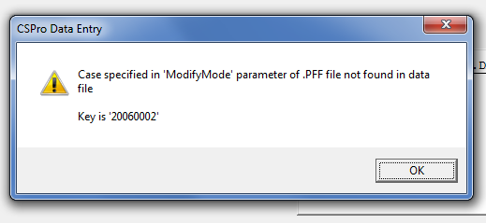
Interview status in menu isn’t corrrect
Problem | Solution
Try to enter household but the menu refuses, and the interview exists on the tablet according to option A | Interviewer does BT Transfer to supervisor Supervisor sends assignment file back to interviewer
Notes:
Go through this section in the manual. It is a good idea to ask participants to read different sections before you explain the section.

Slide 7
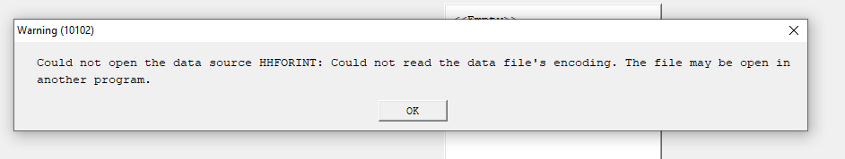
Menu already running on tablet
Problem | Solution
Above message appears when you try to run a menu (supervisor or interviewer). Reason: a menu program is already running on your tablet | Click on menu icon in Windows taskbar at bottom of screen to re-activate the menu that is already running
Notes:
Go through this section in the manual. It is a good idea to ask participants to read different sections before you explain the section.

Slide 8
Avoiding problems with result codes
Golden rule
Before supervisor sends new assignment to an interviewer they should always receive the latest interview data from that interviewer
Doing so ensures that the assignment file they send has result codes consistent with the data on the interviewers tablet
Best solution to inconsistent result codes on interviewers tablet is to
Interviewer sends data to supervisor
Supervisor sends assignment again to interviewer via Bluetooth
No need to change assignments in this case

Slide 9
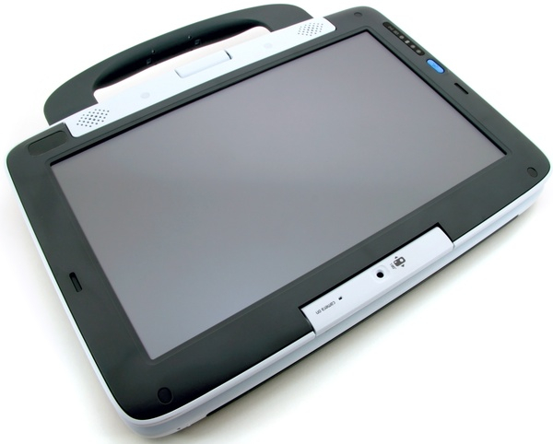
Avoiding problems with result codes
DO THIS FIRST
THEN THIS
Interviewer (sender)
Interviewer (sender)
Bluetooth transfer of interview data
Bluetooth transfer of assignment data
Supervisor (receiver)
Supervisor (receiver)

Slide 10
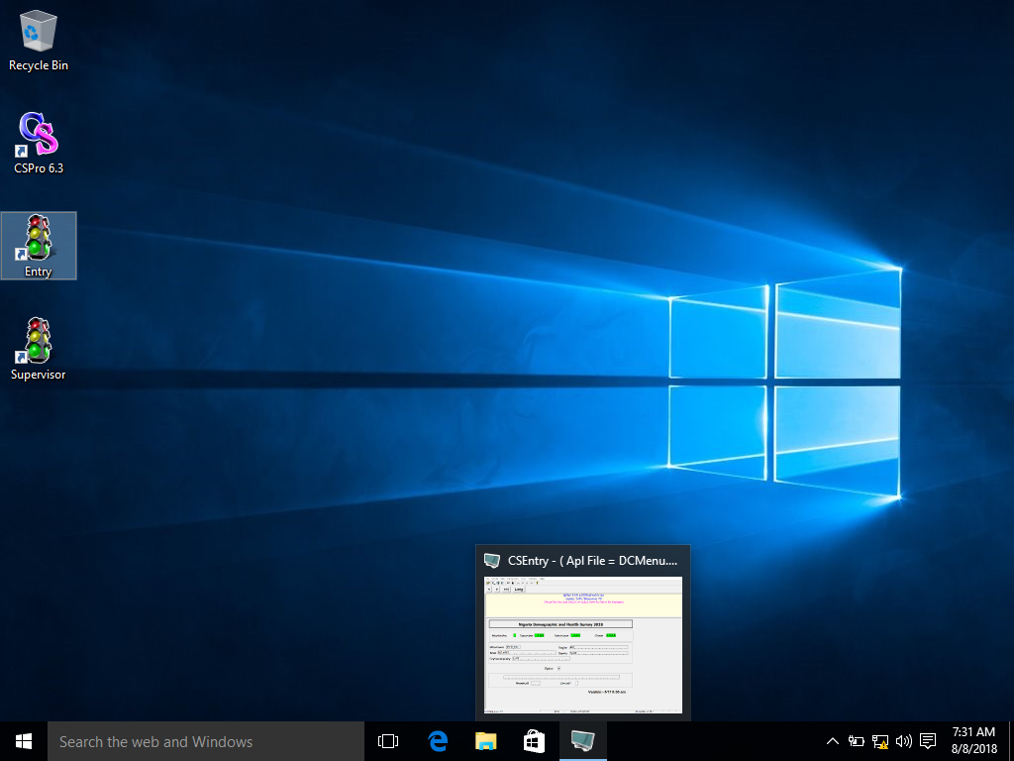
Click on the DHS Menu icon (looks like a computer screen)
Menu already running on tablet
Notes:
Go through this section in the manual. It is a good idea to ask participants to read different sections before you explain the section.

Slide 11
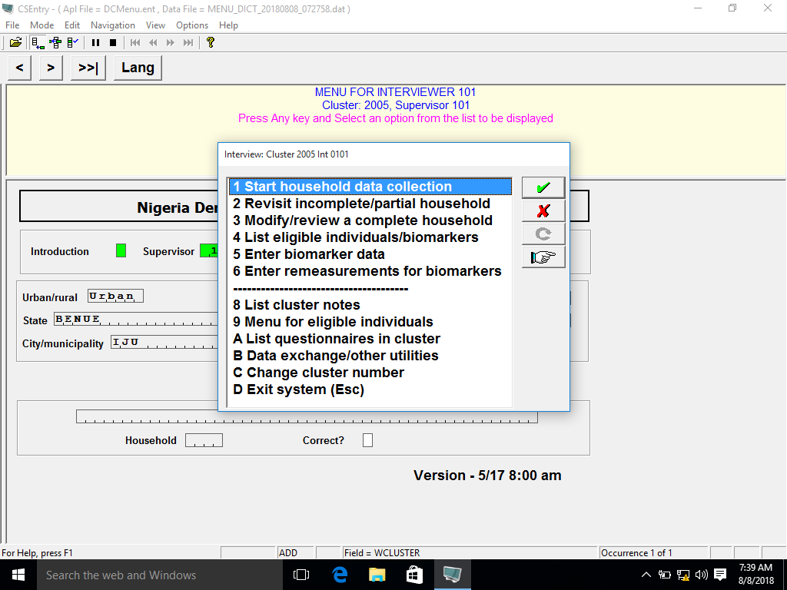
Menu already running on tablet
The menu will be restored to the screen
Notes:
Go through this section in the manual. It is a good idea to ask participants to read different sections before you explain the section.

Slide 12


Hidden Windows
Some options in the menus will launch another program to perform the required task
When the menu launches another program, the menu itself is suspended, meaning it is visible but is waiting for the active program to finish
If you click on or touch the menu window it will become visible but will not be active until the program it has launched is closed
To restore the active program click on the icon for that program at the bottom of the screen
Function | Program | Icon
Bluetooth transfers | Bluetooth utility
Modify ID’s | Id Tool
IFSS | IFSS program

Slide 13
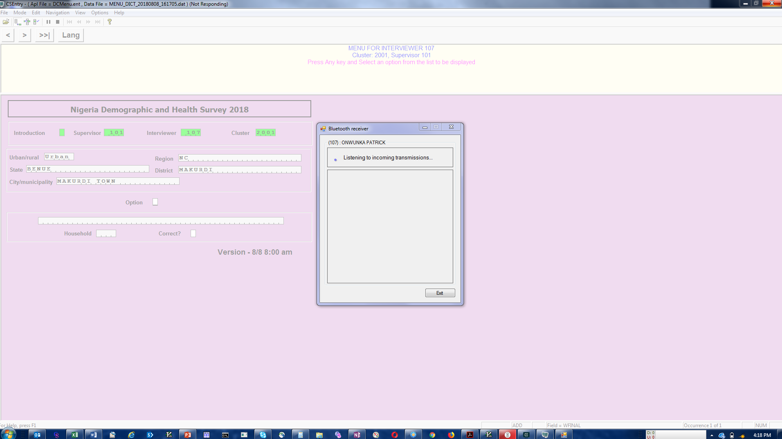
Hidden windows: Bluetooth
When the Bluetooth window is launched from the menu, the menu screen is suspended until the Bluetooth transfer window is closed
The menu screen remains inactive while it is suspended and will not accept any input from the user (is “frozen”)
When the Bluetooth window is closed the menu will be reactivated
Notes:
Go through this section in the manual. It is a good idea to ask participants to read different sections before you explain the section.

Slide 14
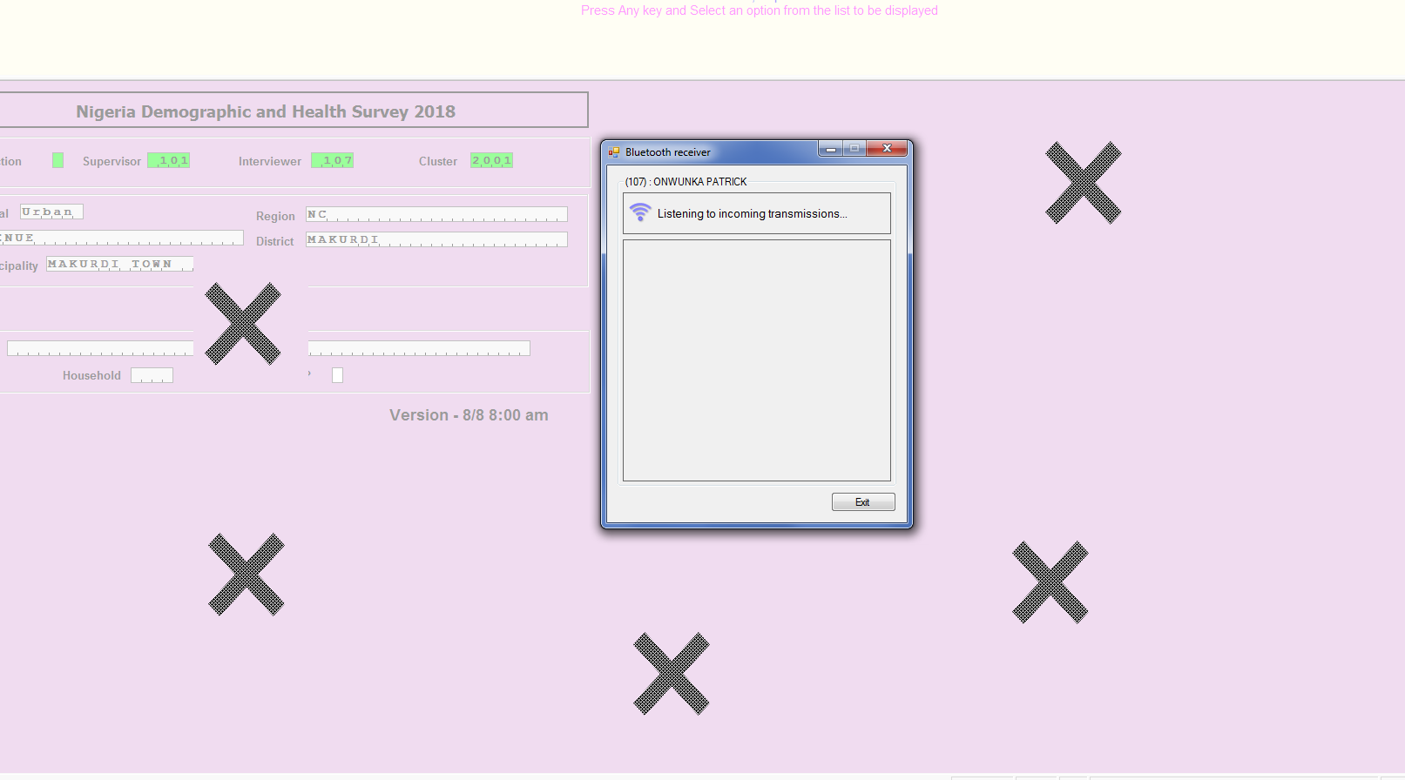
Hidden windows: Bluetooth
Do not click on or touch with your hand the areas of the menu screen behind the Bluetooth transfer window to avoid making the menu screen the active window and hiding the transfer window
Notes:
Go through this section in the manual. It is a good idea to ask participants to read different sections before you explain the section.

Slide 15
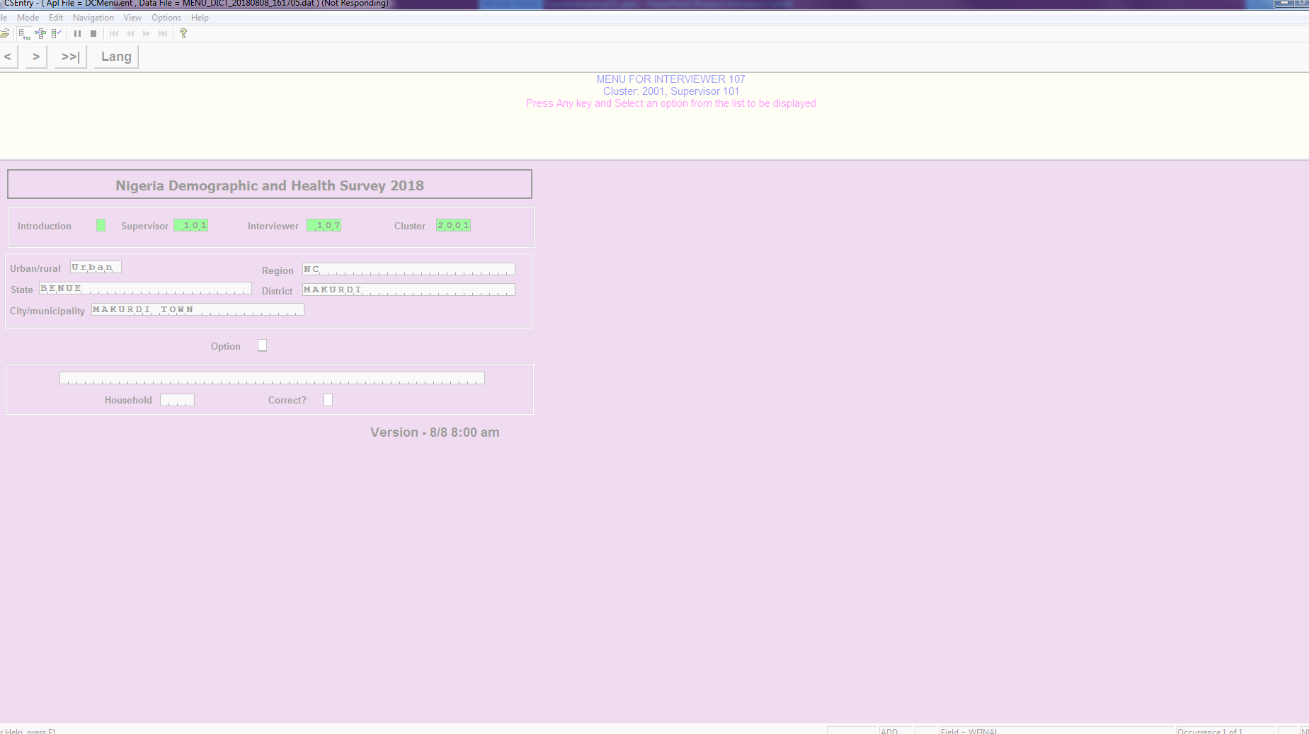
Hidden windows: Bluetooth
*If the suspended menu window is activated it hides the active Bluetooth transfer window and will not respond to input
* To restore the transfer window click on the Bluetooth transfer icon at the bottom of the screen
Notes:
Go through this section in the manual. It is a good idea to ask participants to read different sections before you explain the section.

Slide 16
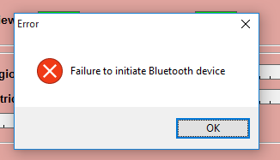
Bluetooth failure
Message on the right usually means Bluetooth has been disabled in error
Solution:
Settings -> Devices -> Bluetooth
Then switch Bluetooth on

Slide 17
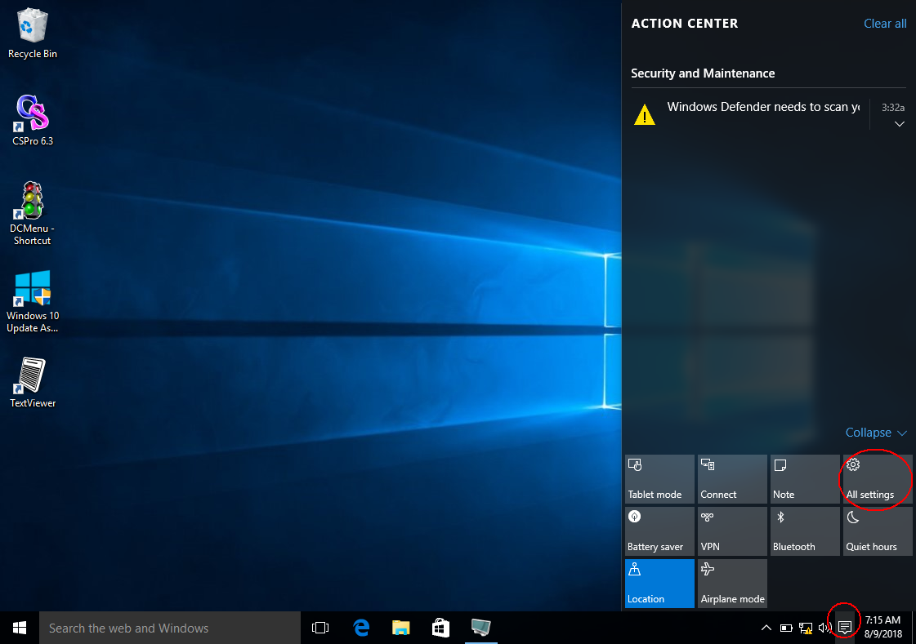
Bluetooth failure

Slide 18
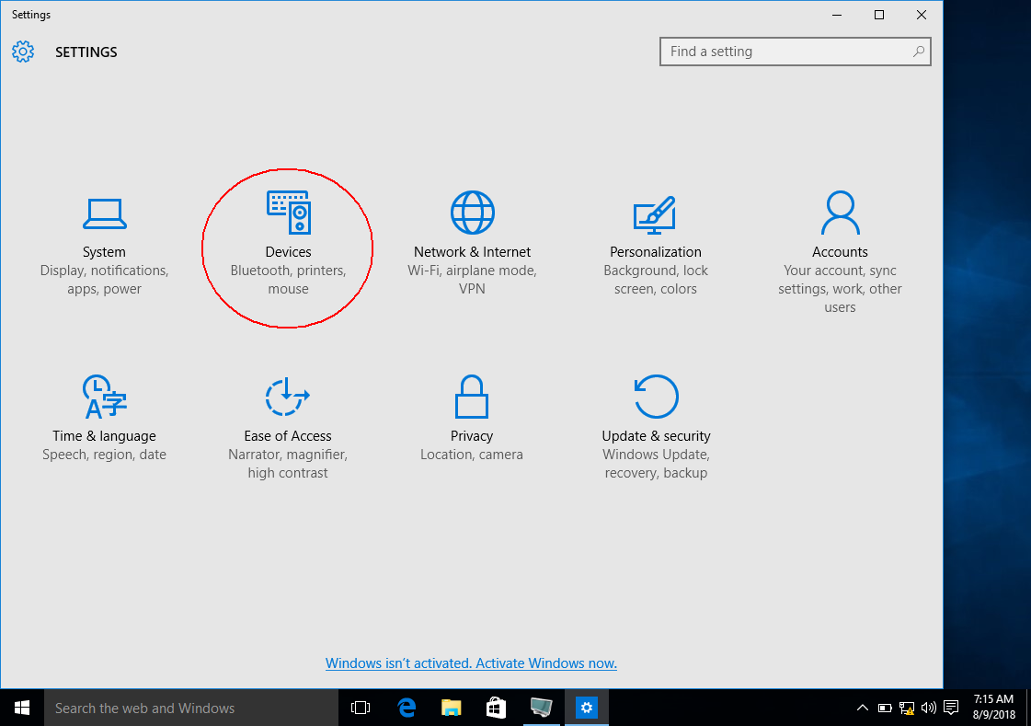
Bluetooth failure

Slide 19
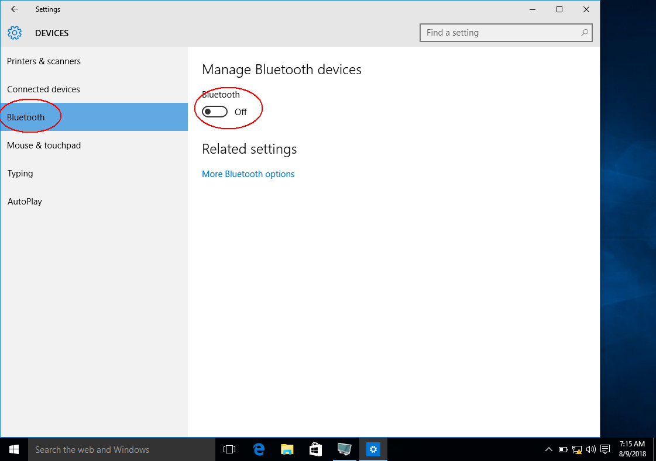
Bluetooth failure

Slide 20
If Bluetooth transfer fails
Try transfer again
If still fails, check Bluetooth settings and switch Bluetooth device off and on for both tablets
Try again
If still fails, shut down both tablets and try again
If still fails, check Bluetooth settings to verify no devices are paired and unpair if necessary
If still fails, contact IT support

Slide 21
Avoiding problems with Bluetooth transfers
Receive must always wait until sender is ready
Put in receive mode just before sender sends
Work together as a team
Never put machine in receive mode before sender is ready to send

Slide 22
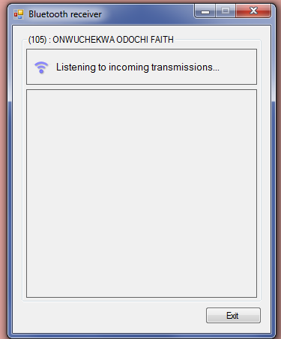
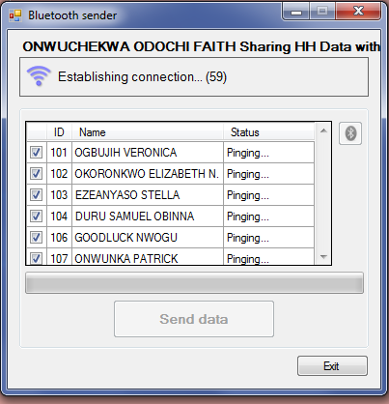
Avoiding problems with Bluetooth transfers
Step 1. Sender is ready to send, signals to receiver that they are ready
Step 2. Receiver starts receiving
Step 3. Sender starts sending

Slide 23
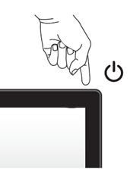
Tablet freezes
If tablet freezes and cannot respond to any input, hold down the button on the top right of the screen continuously until all lights on the tablet go off
Tablet is now shut down
Restart the tablet and determine if the problem persists

Slide 24
Be security conscious in the field
Take care when staying in places frequented by public eg hotels, hostels
Don’t advertise that your team have Tablets to others
Consider using paper questionnaires if there would be significant risk in bringing Tablets into a cluster

Slide 25



Avoiding computer viruses
Viruses can destroy data and disable tablets !
Don’t give mobile hotspot password to interviewers
Loading media eg videos, music on tablets is prohibited
Downloading or Installing non- NDHS related software on tablets is prohibited
You are responsible for enforcing these rules
You will be responsible if viruses appear

Slide 26
Treatment of tablets
Treat with great care
Should be in protective cases at all times
Be careful when storing to avoid scratching screen
Avoid exposing to strong sunlight, excess heat
Avoid exposing to water
Avoid dropping, shocks, impacts

Slide 27
Troubleshooting
If interviewer tablet fails
Can use supervisor tablet as backup until spare arrives
If use supervisor tablet use the supervisor interviewer code
If use another interviewer/biomarker person’s tablet, use the code of the interviewer whose tablet failed for their interviews
Can also use paper questionnaires

Slide 28
Troubleshooting (cont)
When reporting a problem to IT team please provide all the following information :
Type of questionnaire (if applicable)
Question (if applicable)
Events leading up to problem (what combination of circumstances causes it?)
Exact text of message produced (write down before clicking ‘ok’)
Use smart phone to take photos of screen and send if possible

